Slide 1
Pre-event Webinar & Workshop: July 2021 OGC API Virtual Code Sprint
July 14, 2021
#OGCAPI

Slide 2
Agenda
Welcome
Overview of OGC API – Processes
Overview of OGC API – Records
Overview of OGC API – Coverages
Questions & Answers

Slide 5
Welcome
OGC invites you to the July 2021 OGC API Virtual Code Sprint, to be held virtually on:
Day 1: Wednesday 21 July from 07:00am to 05:30pm EDT.
Day 2: Thursday 22 July from 07:00am to 05:30pm EDT.
Day 3: Friday 23 July from 07:00am to 05:30pm EDT.
What is an OGC Code Sprint?
A collaborative and inclusive event driven by innovative and rapid programming with minimal process and organization constraints to support the development of new applications and open standards.

Slide 6
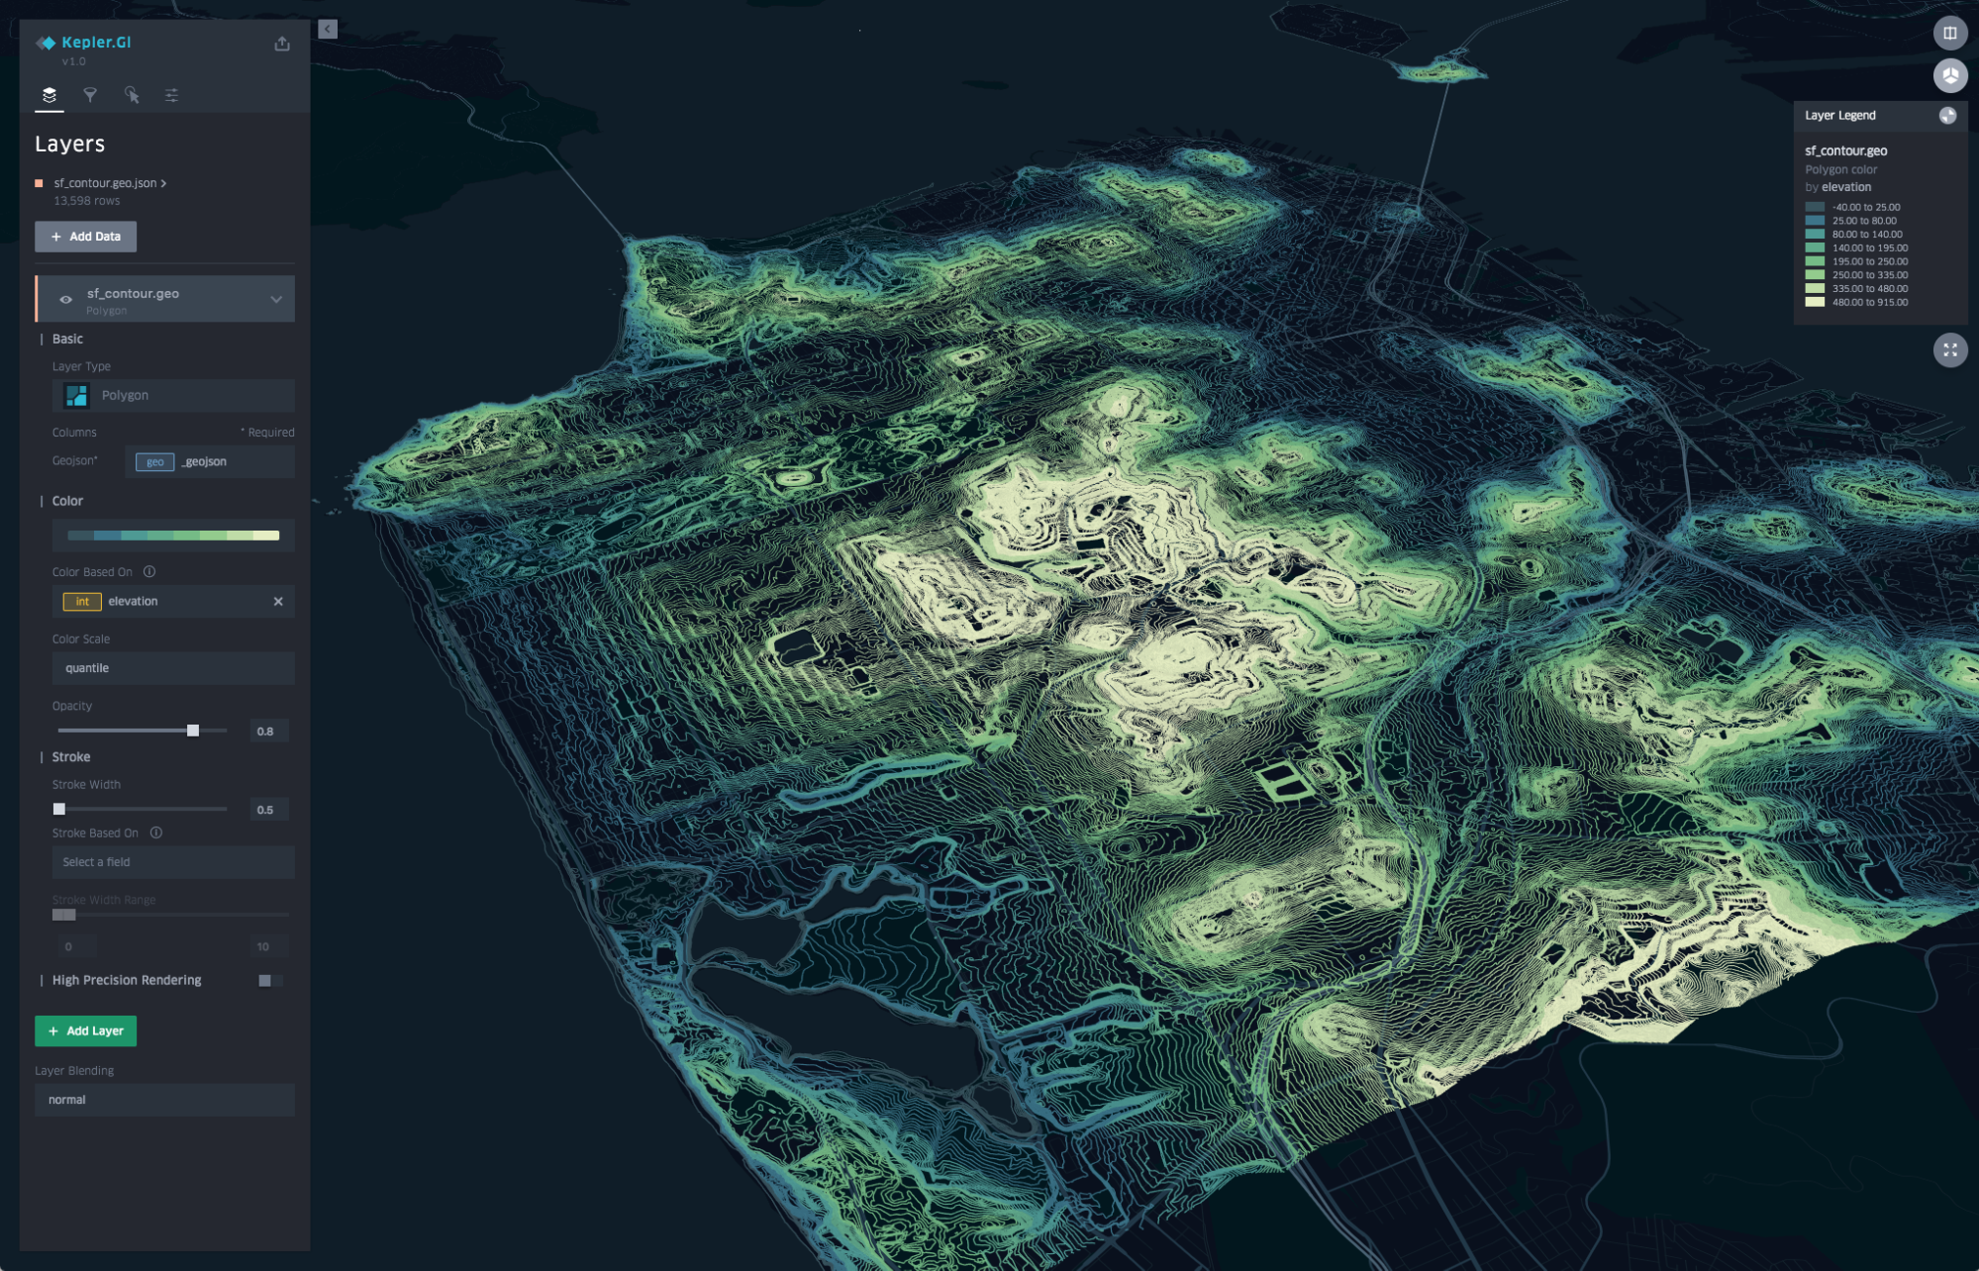
Motivation
The growing uptake of location within and beyond geospatial developer communities

Slide 7



Motivation
APIs are a popular, effective method for rapid software development

Slide 8

Motivation
There is an increasing need for interoperability between Web APIs

Slide 9


Participants
Who is joining this Sprint?
I have several years of professional software development experience and write code almost every day.
Coding is not my day to day job, but I often hack on things to solve key problems.

Slide 10
Overview of the draft specification
OGC API – Processes – Part 1: Core

Slide 11
Overview of the draft specification
OGC API – Records – Part 1: Core

Slide 12
Overview of the draft specification
OGC API – Coverages – Part 1: Core

Slide 13
Sprint Description
The scope of the code sprint is to include:
API implementation
API testing and feedback
Discussion and knowledge sharing
Participants are welcome to bring partial or complete implementations of servers or clients to support the sprint.
Participants will have the opportunity to experiment with parts of the specifications and develop working implementations.

Slide 14
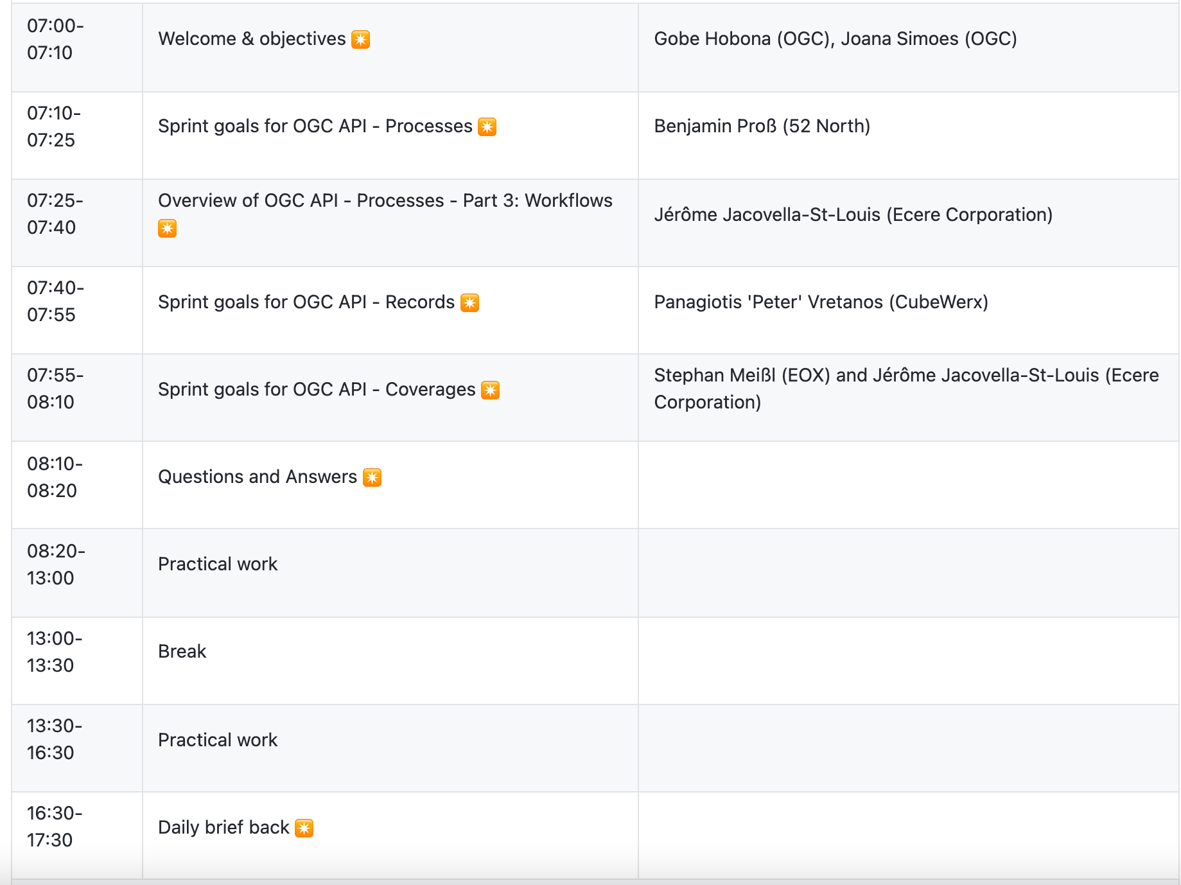
Sprint Schedule – Day 1 – July 21
Notes:
All times are in EDT

Slide 15
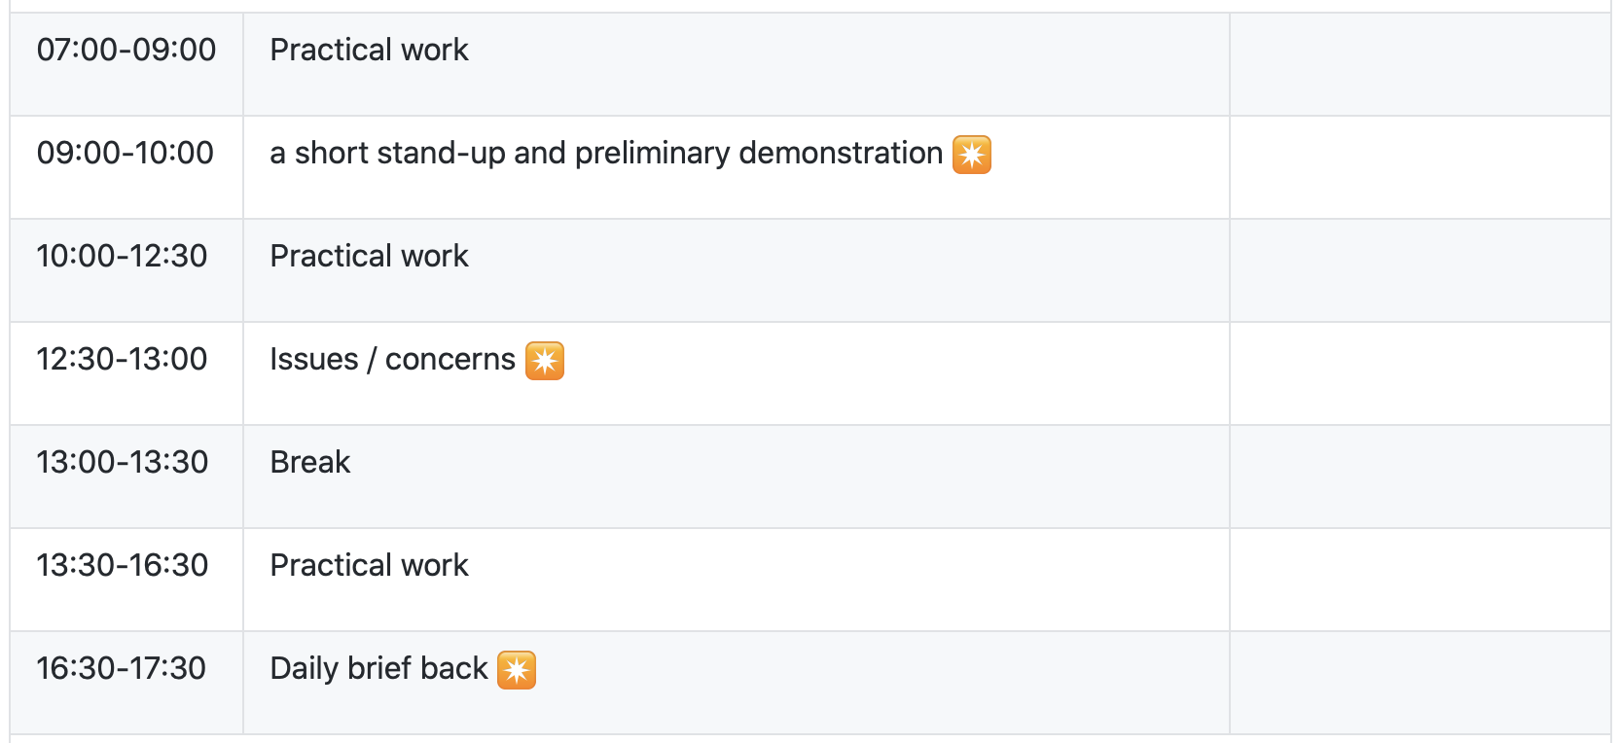
Sprint Schedule – Day 2 – July 22

Slide 16
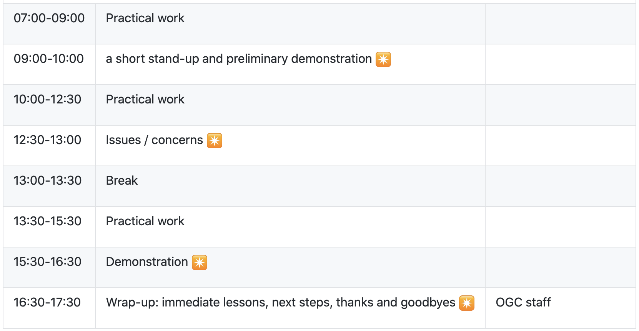
Sprint Schedule – Day 3 – July 23

Slide 17
Logistics
Gotomeeting
Link to be provided to registered participants only.
Gitter
https://gitter.im/ogc-developer/Sprints
GitHub
Sprint repo https://github.com/opengeospatial/ogcapi-code-sprint-2021-07

Slide 18

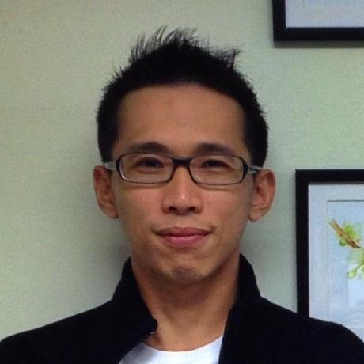



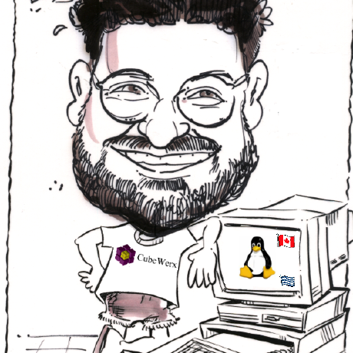




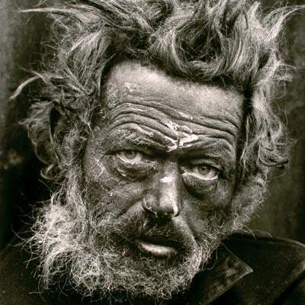





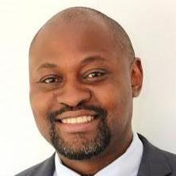





What is Everybody going to be working on?

Slide 19
Community
500+ International Members
110+ Member Meetings
60+ Alliance and Liaison partners
50+ Standards Working Groups
45+ Domain Working Groups
25+ Years of Not for Profit Work 10+ Regional and Country Forums
Innovation
120+ Innovation Initiatives
380+ Technical reports
Quarterly Tech Trends monitoring
Standards
65+ Adopted Standards
300+ products with 1000+ certified implementations
1,700,000+ Operational Data Sets Using OGC Standards
Contact info@ogc.org to schedule a meeting for an in-depth discussion with OGC staff and join our community today!

